Slide 1
— Practice 12 Light GBM + Optuna + Shapley
MATH2319 Machine Learning

Slide 2

Light Gradient Boosting Machine
It is faster
It can handle missing values “natively”
It can handle categorical features “natively”

Slide 3
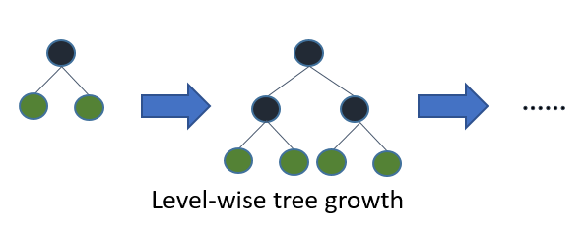
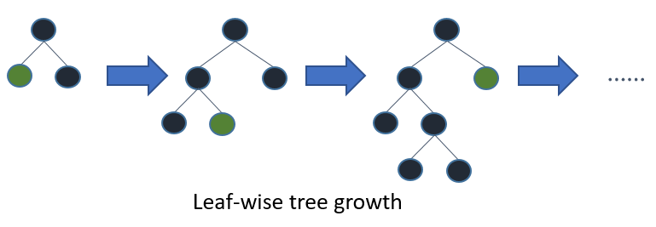

How does the tree grow?
Source: Light GBM, https://lightgbm.readthedocs.io/en/v3.3.2/Features.html#leaf-wise-best-first-tree-growth

Slide 4



Bayesian optimisation approach
Tree Parzen Estimator
A good candidate should have…
Low probability under the “bad” distribution
High probability under the “good” distribution
Grid search
Random sampling
Which hyperparameters are more important?

Slide 5

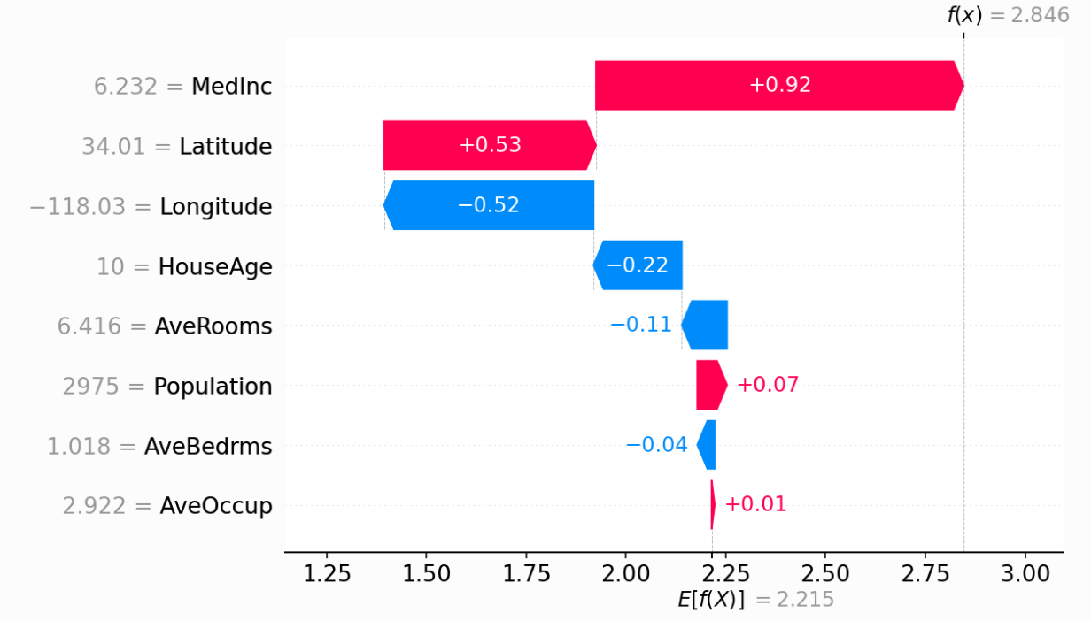

Make your model more “interpretable”
Which features are more important?
Additive nature

Slide 6
— Let’s switch to

